Slide 1

Unsupervised Learning Approach- Clustering Algorithms

Slide 2
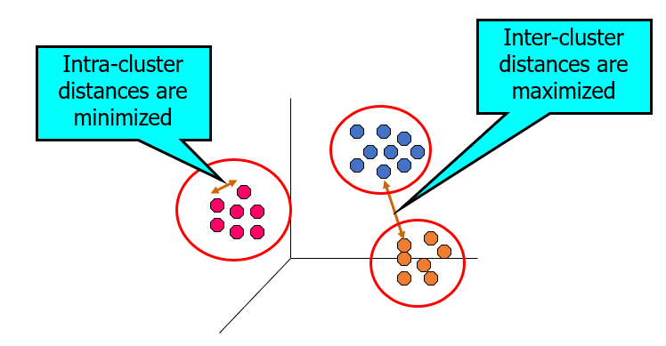
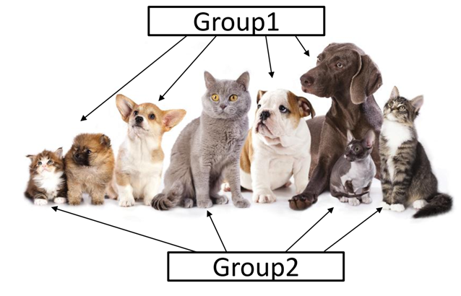
Unsupervised Learning- Clustering
Clustering refers to a very broad set of techniques for finding subgroups in a data set.

Slide 3
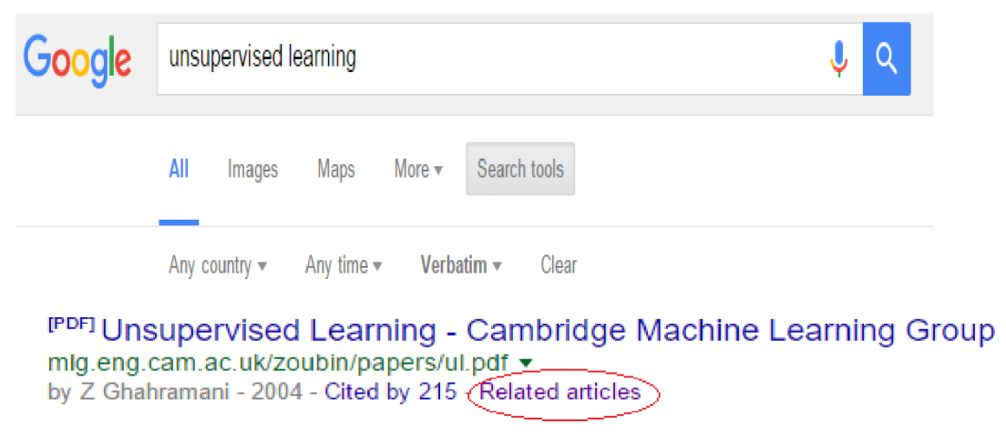
Applications of Clustering: Search Result

Slide 4
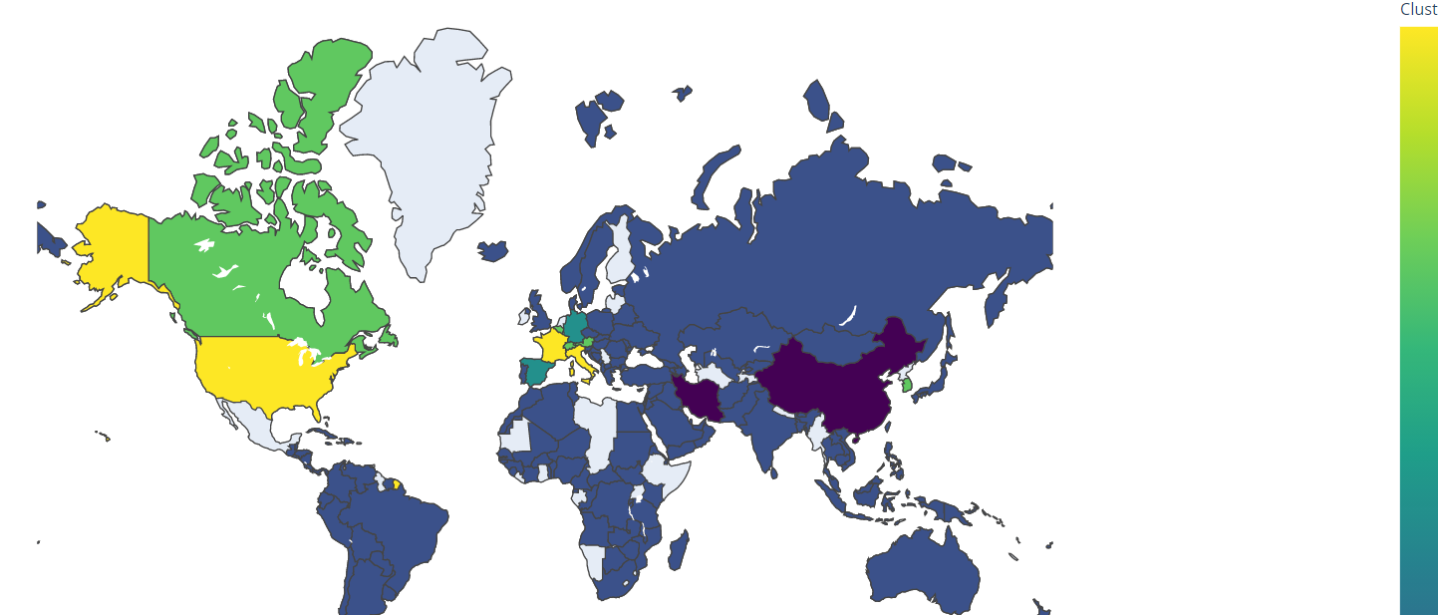
Applications of Clustering: Visualization
Clustering World Countries affected by Coronavirus

Slide 5
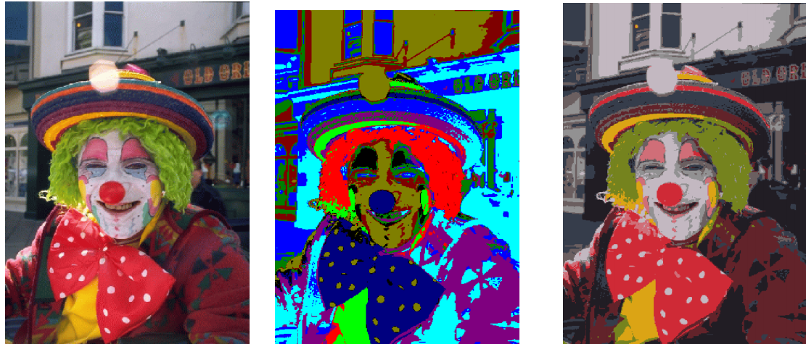
Applications of Clustering: Image Segmentation

Slide 6
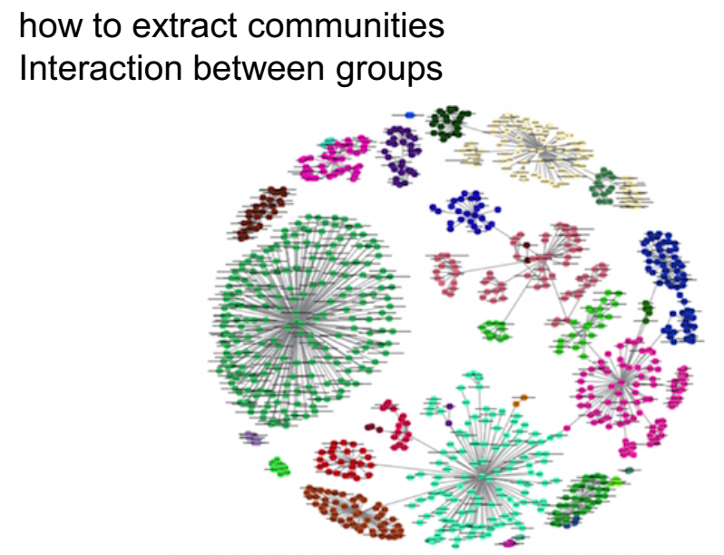
Applications of Clustering: Social network analysis

Slide 7
k-Means algorithm [1957, 1967]
k-Medoids algorithm
k-Modes [1998]
Fuzzy c-means algorithm [1999]
PAM [1990] Partitioning Around Medoids
CLARA [1990] Clustering Large Applications
CLARANS [1994]
Clustering based on RANdomized Search
Partitioning methods
Divisive
DIANA [1990] Divisive Analysis
Hierarchical methods
AGNES [1990]
BIRCH [1996]
CURE [1998]
ROCK [1999]
Chamelon [1999]
Agglomerative methods
Clustering Techniques
Density-based methods
STING [1997]
DBSCAN [1996]
CLIQUE [1998]
DENCLUE [1998]
OPTICS [1999]
Wave Cluster [1998]
Graph based methods
MST Clustering [1999]
OPOSSUM [2000]
SNN Similarity Clustering [2001, 2003]
EM Algorithm [1977]
Auto class [1996]
COBWEB [1987]
ANN Clustering [1982, 1989]
Model based clustering

Slide 8
Types of Clustering: partitional vs hierarchical
Partitional Clustering
A division data objects into non-overlapping subsets (clusters) such that each data object is in exactly one subset
Original Points
A Partitional Clustering

Slide 9
Types of Clustering: partitional vs hierarchical
Traditional Hierarchical Clustering
Traditional Dendrogram
Hierarchical Clustering: A set of nested clusters organized as a hierarchical tree

Slide 10
Types of Clustering
Exclusive versus non-exclusive
In non-exclusive clustering's, points may belong to multiple clusters.
Can represent multiple classes or ‘border’ points
Fuzzy versus non-fuzzy
In fuzzy clustering, a point belongs to every cluster with some weight between 0 and 1
Weights must sum to 1
Partial versus complete
In some cases, we only want to cluster some of the data

Slide 11
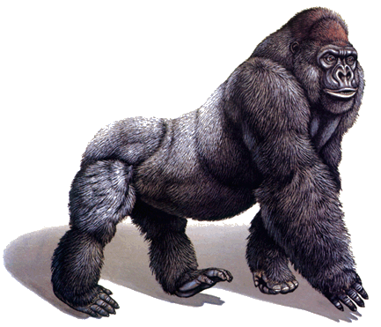
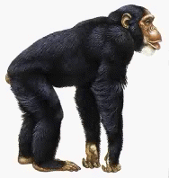
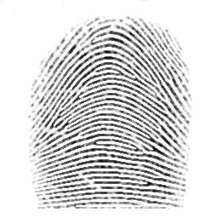
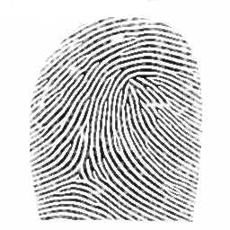
Similarity Measures
Definition: Let O₁ and O₂ be two objects from the universe of possible objects. The distance (dissimilarity) between O₁ and O₂ is a real number denoted by D(O₁,O₂)
Peter
Piotr
0.23
3
342.7

Slide 12
Properties of distance measure
D(A,B) = D(B,A) Symmetry
D(A,A) = 0 Constancy of Self-Similarity
D(A,B) = 0 iif A= B Positivity (Separation)
D(A,B) ≤ D(A,C) + D(B,C) Triangular Inequality
D(A,B) = D(B,A)
Otherwise “Alex looks like Bob, but Bob looks nothing like Alex.”
D(A,B) ≤ D(A,C) + D(B,C)
Otherwise “Alex is very like Bob, and Alex is very like Carl, but Bob is very unlike Carl.”

Slide 13
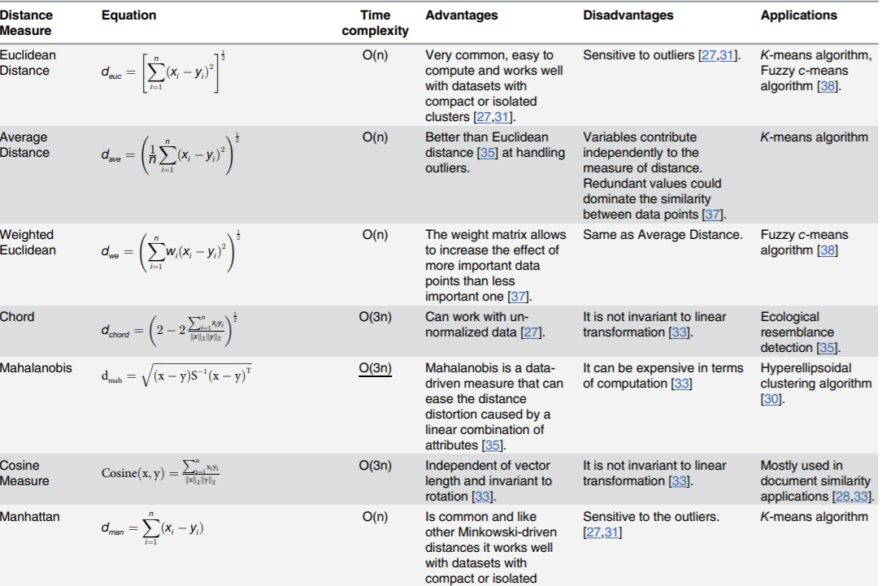

Slide 14
Clustering techniques
Partitioning
k-Means algorithm
PAM (k-Medoids algorithm)
Hierarchical
Divisive algorithm
Agglomerative algorithm
Density – Based
DBSCAN (Density-Based Spatial Clustering of Applications with Noise)

Slide 15
k-Means Clustering
Clustering used to group similar observations and form different groups-
Property 1: All the data points in a cluster should be similar to each other.
Property 2: The data points from different clusters should be as different as possible
k-Means clustering algorithm proposed by J. Hartigan and M. A. Wong [1979].
Partitional Clustering
Centroid-based algorithm (distance-based algorithm)
Objective : minimize the sum of distances between the points and their respective cluster centroid
Given a set of n distinct objects, the k-Means clustering algorithm partitions the objects into k number of clusters such that intracluster similarity is high but the intercluster similarity is low.

Slide 16
k-Means Algorithm
Input: D is a dataset containing n objects, and k is the number of clusters
Output: A set of k clusters
Steps:
Randomly choose k objects from D as the initial cluster centroids.
For each of the objects in D do
Compute distance between the current objects and k cluster centroids
Assign the current object to that cluster to which it is closest.
Compute the “cluster centers” of each cluster. These become the new cluster centroids.
Repeat step 2-3 until the convergence criterion is satisfied
Stop

Slide 17
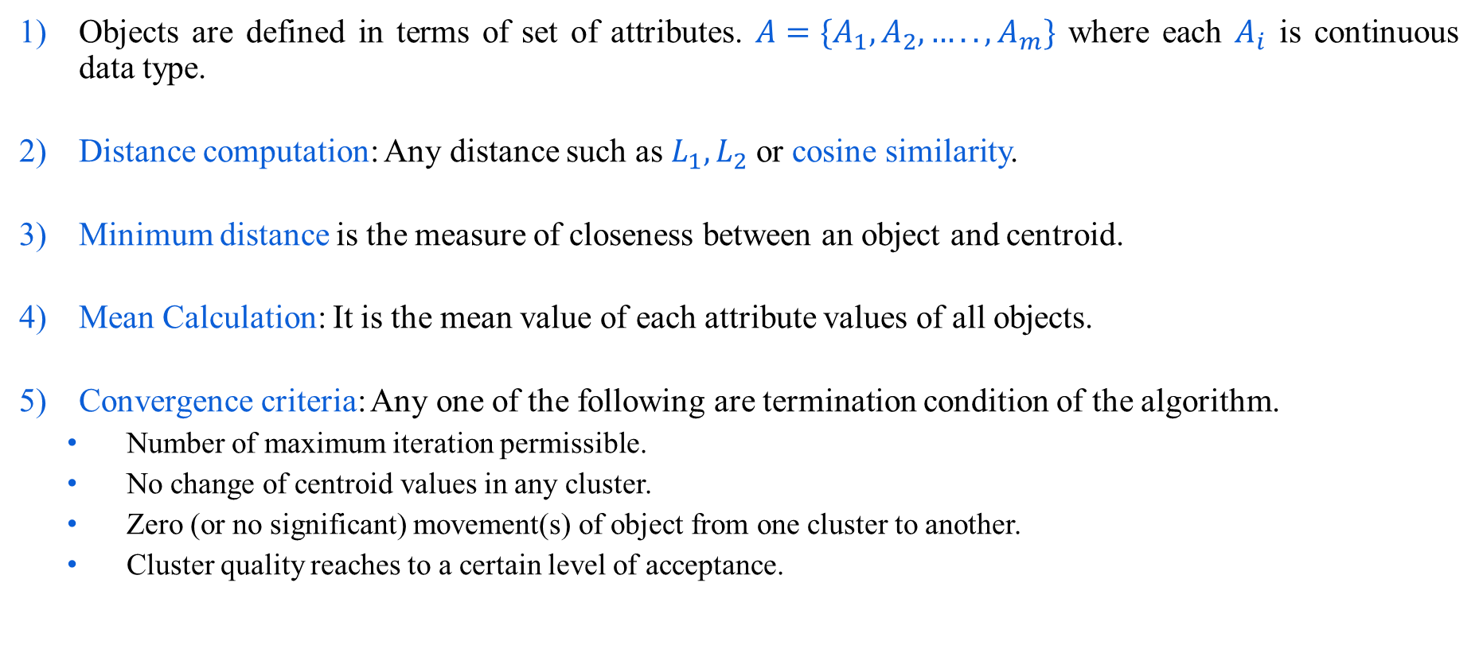
k-Means Algorithm
Objects are defined in terms of set of attributes. ${A=\{A}_{1},A_{2},…..,A_{m}\}$ where each $A_{i}$ is continuous data type.
Distance computation: Any distance such as $L_{1},L_{2}$or cosine similarity.
Minimum distance is the measure of closeness between an object and centroid.
Mean Calculation: It is the mean value of each attribute values of all objects.
Convergence criteria: Any one of the following are termination condition of the algorithm.
Number of maximum iteration permissible.
No change of centroid values in any cluster.
Zero (or no significant) movement(s) of object from one cluster to another.
Cluster quality reaches to a certain level of acceptance.

Slide 18
Illustration of k-Means clustering algorithms
Objects with two attributes $A_{1}$ and $A_{2}$
A₁ | A₂
6.8 | 12.6
0.8 | 9.8
1.2 | 11.6
2.8 | 9.6
3.8 | 9.9
4.4 | 6.5
4.8 | 1.1
6.0 | 19.9
6.2 | 18.5
7.6 | 17.4
7.8 | 12.2
6.6 | 7.7
8.2 | 4.5
8.4 | 6.9
9.0 | 3.4
9.6 | 11.1
Centroid |  | Objects
 | A1 |  | A2
c₁ | 3.8 |  | 9.9
c₂ | 7.8 |  | 12.2
c₃ | 6.2 |  | 18.5

Slide 19
Illustration of k-Means clustering algorithms
Suppose, k=3. Three objects are chosen at random shown as circled. These three centroids are shown below.
Initial Centroids chosen randomly
Let us consider the Euclidean distance measure (L₂ Norm) as the distance measurement in our illustration.
Let d₁, d₂ and d₃ denote the distance from an object to c₁, c₂ and c₃ respectively. The distance calculations are shown in Table
Assignment of each object to the respective centroid is shown in the right-most column and the clustering so obtained is shown in Figure
Centroid |  | Objects
 | A1 |  | A2
c₁ | 3.8 |  | 9.9
c₂ | 7.8 |  | 12.2
c₃ | 6.2 |  | 18.5

Slide 20
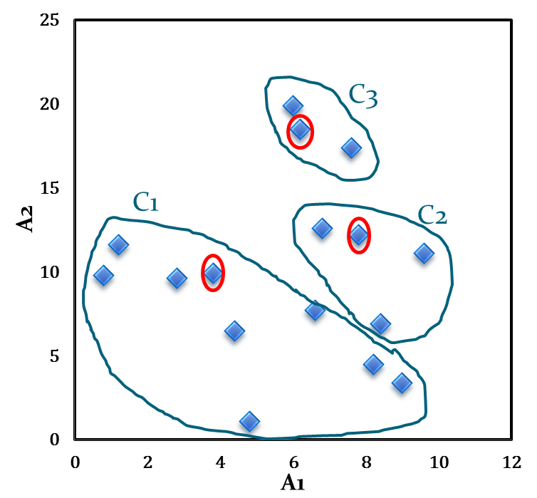
Illustration of k-Means clustering algorithms
A₁ | A₂ | d₁ | d₂ | d₃ | _{cluster}
6.8 | 12.6 | 4.0 | 1.1 | 5.9 | 2
0.8 | 9.8 | 3.0 | 7.4 | 10.2 | 1
1.2 | 11.6 | 3.1 | 6.6 | 8.5 | 1
2.8 | 9.6 | 1.0 | 5.6 | 9.5 | 1
3.8 | 9.9 | 0.0 | 4.6 | 8.9 | 1
4.4 | 6.5 | 3.5 | 6.6 | 12.1 | 1
4.8 | 1.1 | 8.9 | 11.5 | 17.5 | 1
6.0 | 19.9 | 10.2 | 7.9 | 1.4 | 3
6.2 | 18.5 | 8.9 | 6.5 | 0.0 | 3
7.6 | 17.4 | 8.4 | 5.2 | 1.8 | 3
7.8 | 12.2 | 4.6 | 0.0 | 6.5 | 2
6.6 | 7.7 | 3.6 | 4.7 | 10.8 | 1
8.2 | 4.5 | 7.0 | 7.7 | 14.1 | 1
8.4 | 6.9 | 5.5 | 5.3 | 11.8 | 2
9.0 | 3.4 | 8.3 | 8.9 | 15.4 | 1
9.6 | 11.1 | 5.9 | 2.1 | 8.1 | 2
Centroid |  | Objects
 | A1 |  | A2
c₁ | 3.8 |  | 9.9
c₂ | 7.8 |  | 12.2
c₃ | 6.2 |  | 18.5
Initial clusters

Slide 21
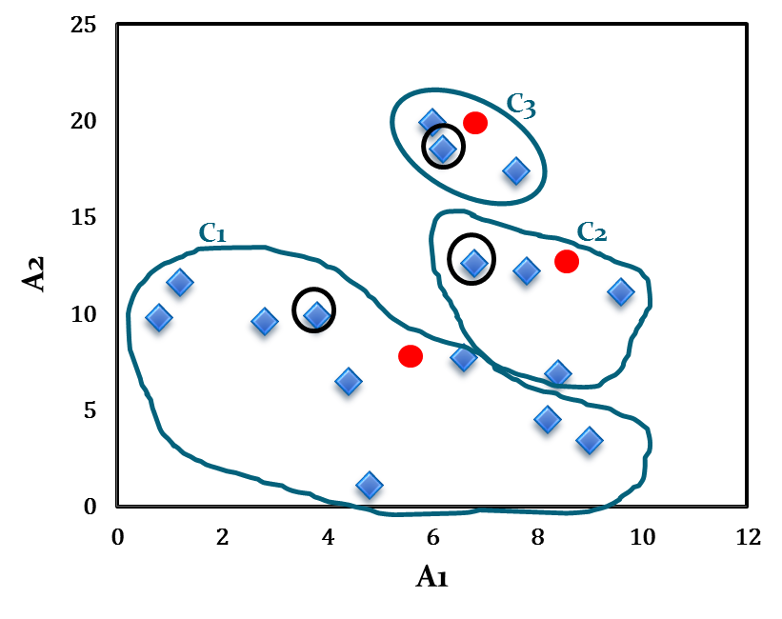
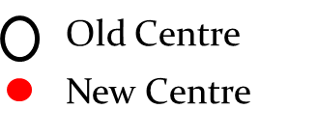
Illustration of k-Means clustering algorithms
The calculation of the new centroids of the three-clusters using the mean of attribute values of A₁ and A₂ is shown in the table below. The cluster with new centroids is shown in Fig.
Calculation of new centroids
New Centroid |  | Objects
 | A1 |  | A2
c₁ | 4.6 |  | 7.1
c₂ | 8.2 |  | 10.7
c₃ | 6.6 |  | 18.6
Initial cluster with new centroids

Slide 22
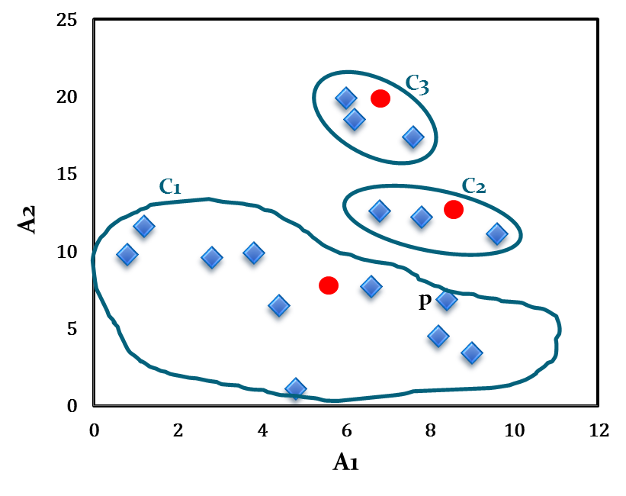
Illustration of k-Means clustering algorithms
Note that point p moves from cluster C₂ to cluster C₁.
Cluster after first iteration

Slide 23
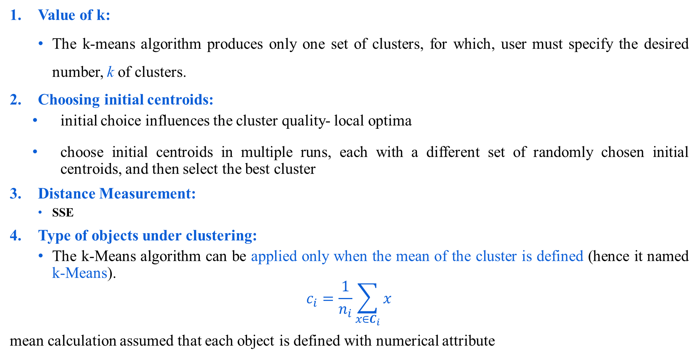
Comments on k-Means algorithm
Value of k:
The k-means algorithm produces only one set of clusters, for which, user must specify the desired number, k of clusters.
Choosing initial centroids:
initial choice influences the cluster quality- local optima
choose initial centroids in multiple runs, each with a different set of randomly chosen initial centroids, and then select the best cluster
Distance Measurement:
SSE
Type of objects under clustering:
The k-Means algorithm can be applied only when the mean of the cluster is defined (hence it named k-Means).
$$c_{i}=\frac{1}{n_{i}}\sum_{x∈C_{i}}{x}$$
mean calculation assumed that each object is defined with numerical attribute

Slide 24
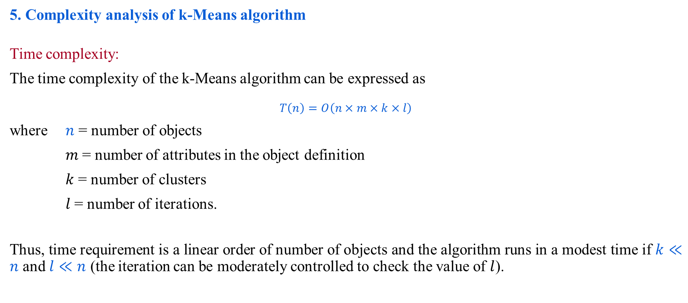
Comments on k-Means algorithm
5. Complexity analysis of k-Means algorithm
Time complexity:
The time complexity of the k-Means algorithm can be expressed as
$$T\left(n\right)=O\left(n×m×k×l\right)$$
where $n$ = number of objects
$m$= number of attributes in the object definition
$k$ = number of clusters
$l$= number of iterations.
Thus, time requirement is a linear order of number of objects and the algorithm runs in a modest time if $k≪n$ and $l≪n$ (the iteration can be moderately controlled to check the value of $l$).

Slide 25
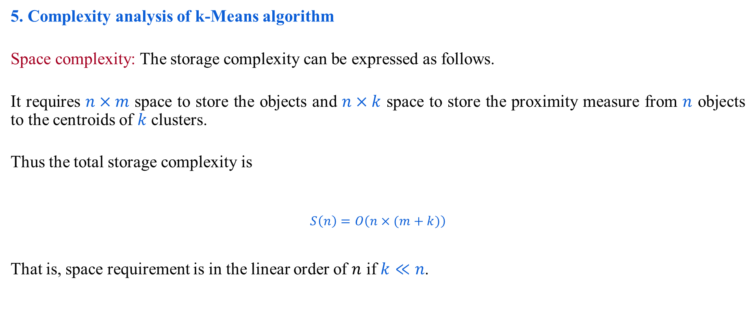
Comments on k-Means algorithm
5. Complexity analysis of k-Means algorithm
Space complexity: The storage complexity can be expressed as follows.
It requires $n×m$ space to store the objects and $n×k$ space to store the proximity measure from $n$ objects to the centroids of $k$ clusters.
Thus the total storage complexity is
$$S\left(n\right)=O\left(n×(m+k)\right)$$
That is, space requirement is in the linear order of $n$ if $k≪n$.

Slide 26
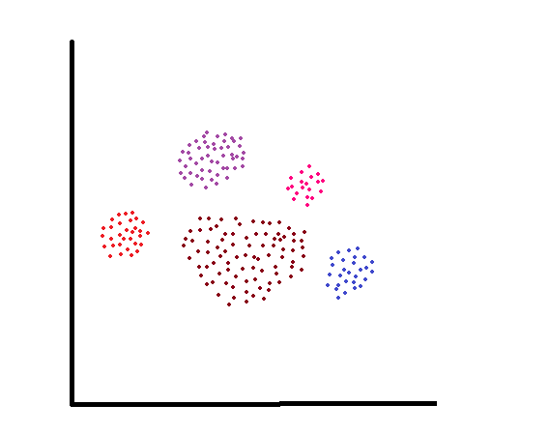
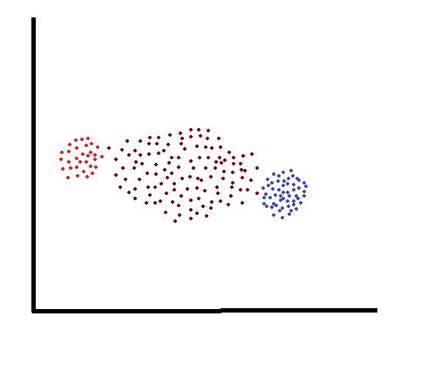
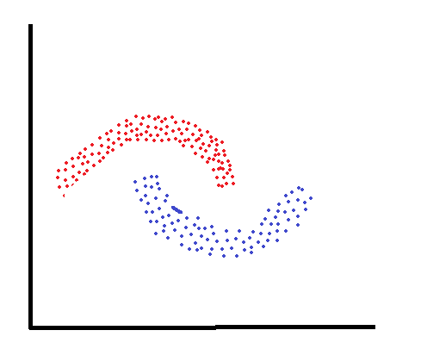
Comments on k-Means algorithm
Limitations :
k-means has trouble clustering data that contains outliers.
k-Means algorithm cannot handle, clusters of different sizes and densities
k-Means algorithm cannot handle non-globular clusters
Scalability issue (and not so practical for large databases).

Slide 27
Summary
K-means clustering is an unsupervised learning algorithm
The goal of this algorithm is to find clusters in the data given number of clusters
Iteratively assign each data point to one of K groups using a similarity measure
The results of the K-means clustering algorithm are:
The centroids of the K clusters, which can be used to label new data
Labels for the training data
Fast, robust and easier to understand.
Relatively efficient
Slides reference: https://cse.iitkgp.ac.in/~dsamanta/courses/da/index.html

Slide 28
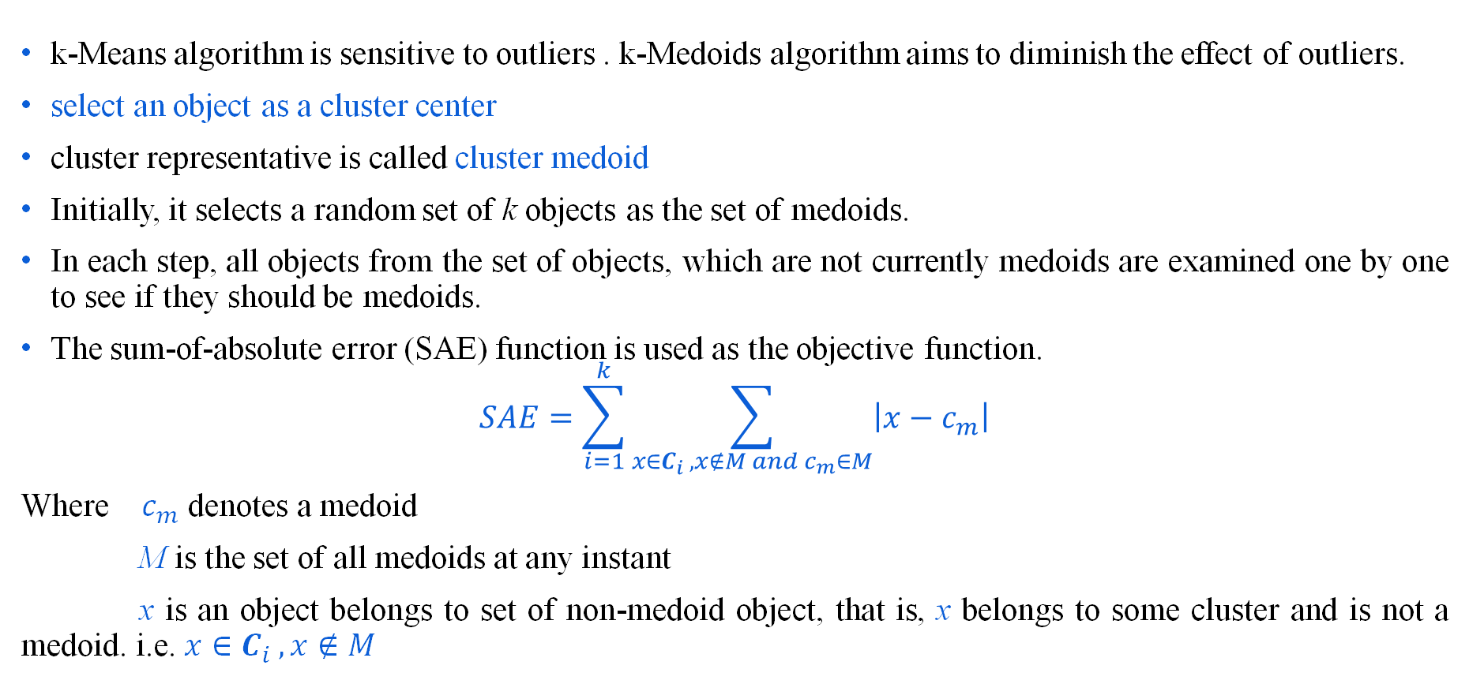
The k-Medoids algorithm
Medoid: The most centrally located point in a cluster, minimizing the sum of distances to all other points in the cluster.
k-Means algorithm is sensitive to outliers . k-Medoids algorithm aims to diminish the effect of outliers.
select an object as a cluster center
cluster representative is called cluster medoid
Initially, it selects a random set of k objects as the set of medoids.
In each step, all objects from the set of objects, which are not currently medoids are examined one by one to see if they should be medoids.
The sum-of-absolute error (SAE) function is used as the objective function.
$$SAE=\sum_{i=1}^{k}{\sum_{x∈C_{i }, x∉M and c_{m}∈M}{\left|x−c_{m}\right|}}$$
Where $c_{m}$ denotes a medoid
M is the set of all medoids at any instant
x is an object belongs to set of non-medoid object, that is, x belongs to some cluster and is not a medoid. i.e. ${x∈C}_{i }, x∉M$

Slide 29
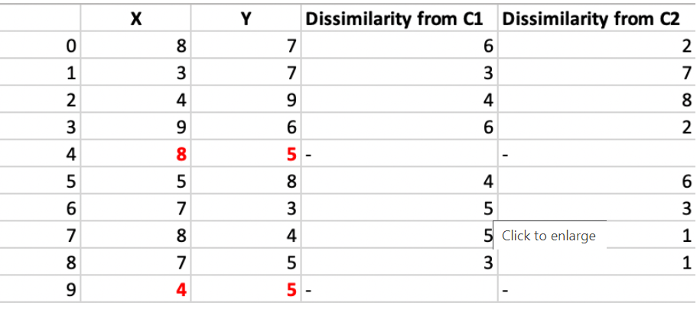
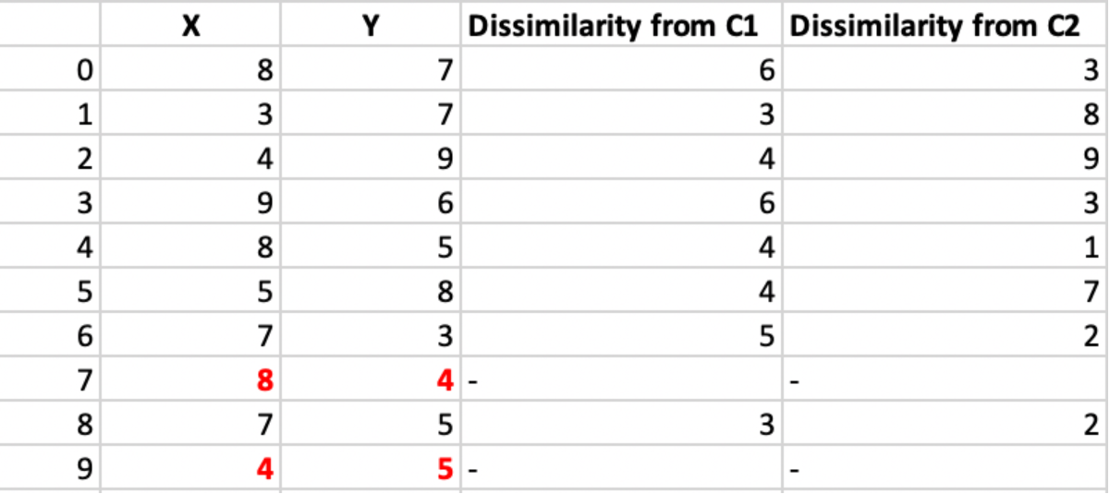
Numerical Example
randomly select one non-medoid point and recalculate the cost. (8, 4)
The points 1, 2, 5 go to cluster C1 and 0, 3, 6, 7, 8 go to cluster C2
Cost = (3 + 4 + 4) + (3 + 1 + 1 + 2 + 2) = 20
New cost = (3 + 4 + 4) + (2 + 2 + 1 + 3 + 3) = 22 Swap Cost = New Cost – Previous Cost = 22 – 20 and 2 >0
As the swap cost is not less than zero, we undo the swap

Slide 30
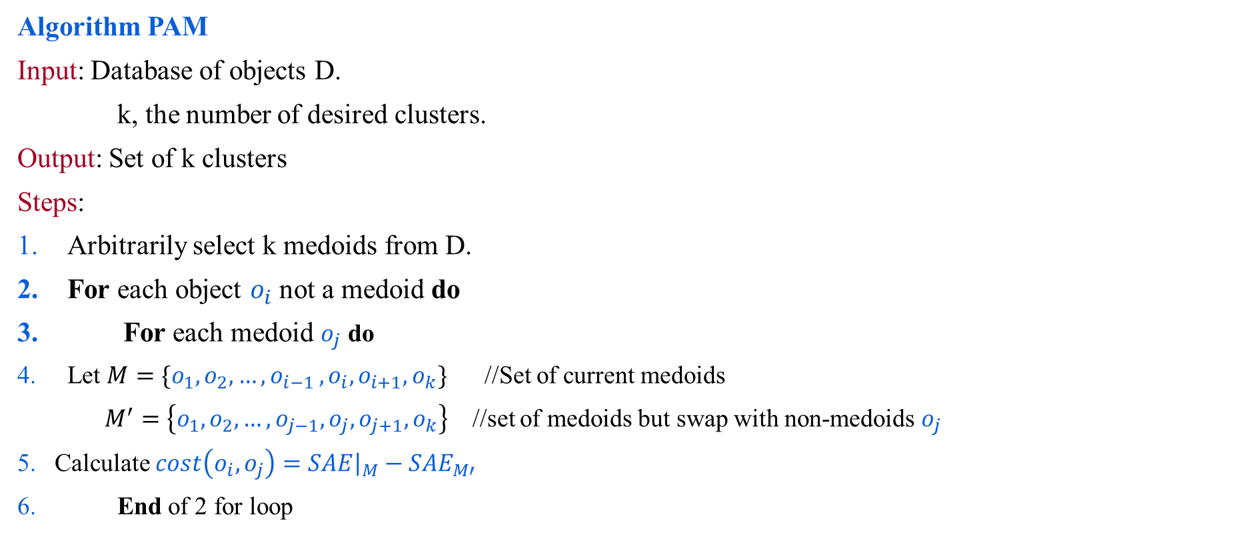
PAM (Partitioning around Medoids)
Algorithm PAM
Input: Database of objects D.
k, the number of desired clusters.
Output: Set of k clusters
Steps:
Arbitrarily select k medoids from D.
For each object $o_{i}$ not a medoid do
For each medoid $o_{j}$ do
Let $M=\{o_{1},o_{2}, …,o_{i−1 },o_{i},o_{i+1},o_{k}\}$ //Set of current medoids
$M^{′}=\left\{o_{1},o_{2}, …,o_{j−1},o_{j},o_{j+1},o_{k}\right\}$ //set of medoids but swap with non-medoids $o_{j}$
Calculate $cost\left(o_{i},o_{j}\right)={\left.SAE\right|}_{M}−{SAE}_{M′}$
End of 2 for loop

Slide 31

PAM (Partitioning around Medoids)
Find $o_{i},o_{j}$for which the $cost(o_{i}$, $o_{j})$ is the smallest.
Replace $o_{i}$ with $o_{j}$ and accordingly update the set M.
Repeat step 2 - step 8 until cost($o_{i}$, $o_{i})≤0$.
Return the cluster with M as the set of cluster centers.
Stop

Slide 32
Hierarchical Clustering
Produces a set of nested clusters organized as a hierarchical tree
Do not have to assume any particular number of clusters
Can be visualized as a dendrogram
A tree like diagram that records the sequences of merges or splits

Slide 33
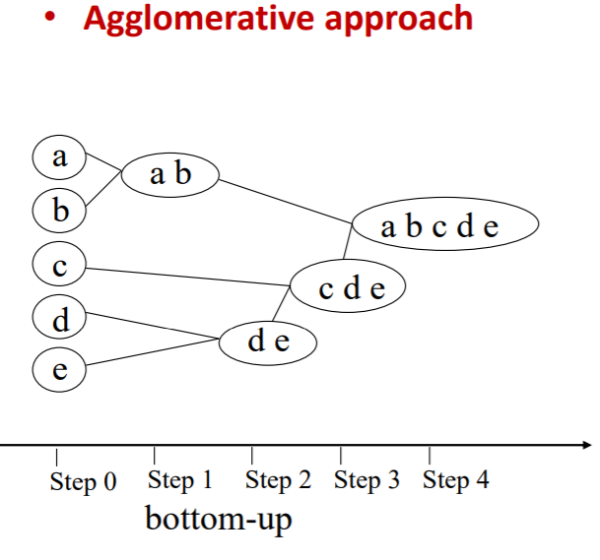
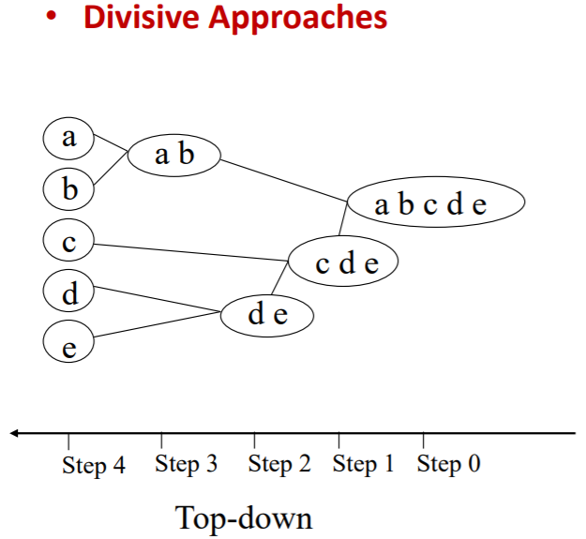
Hierarchical Clustering
Two main types of hierarchical clustering
Agglomerative:
Start with the points as individual clusters
At each step, merge the closest pair of clusters until only one cluster (or k clusters) left
Divisive:
Start with one, all-inclusive cluster
At each step, split a cluster until each cluster contains a point (or there are k clusters)
Traditional hierarchical algorithms use a similarity or distance matrix(proximity matrix)
Merge or split one cluster at a time

Slide 34
Agglomerative Clustering – Initial setup
Start with clusters of individual points and a proximity matrix
p1
p2
p3
p4
p5
. . .
p1
p2
p3
p4
p5
.
.
.
Proximity Matrix

Slide 35
Intermediate Situation
After some merging steps, we have some clusters
C1
C2
C3
C4
C5
C1
C2
C3
C3
C4
C4
C5
Proximity Matrix
C1
C2
C5

Slide 36
Intermediate Situation
We want to merge the two closest clusters (C2 and C5) and update the proximity matrix.
C1
C2
C3
C4
C5
C1
C2
C3
C3
C4
C4
C5
Proximity Matrix
C1
C2
C5

Slide 37
After Merging
C2 U C5
The question is “How do we update the proximity matrix?”
C1
C3
C4
C1
?
C2 U C5
? ? ? ?
C3
C3
?
C4
C4
?
Proximity Matrix
C1
C2 U C5

Slide 38
How to Define Inter-Cluster Similarity
p1
p2
p3
p4
p5
. . .
p1
Similarity?
p2
p3
p4
p5
MIN (Single Link )
MAX
Group Average
Distance Between Centroids
Other methods driven by an objective function
Ward’s Method uses squared error
.
.
.
Proximity Matrix

Slide 39
How to Define Inter-Cluster Similarity
Proximity Matrix
p1
p2
p3
p4
p5
. . .
p1
p2
p3
p4
p5
MIN(Single Link ): Similarity of two clusters is based on the two most similar (closest) points in the different clusters. Determined by one pair of points, i.e., by one link in the proximity graph.
MAX
Group Average
Distance Between Centroids
Other methods driven by an objective function
Ward’s Method uses squared error
.
.
.

Slide 40
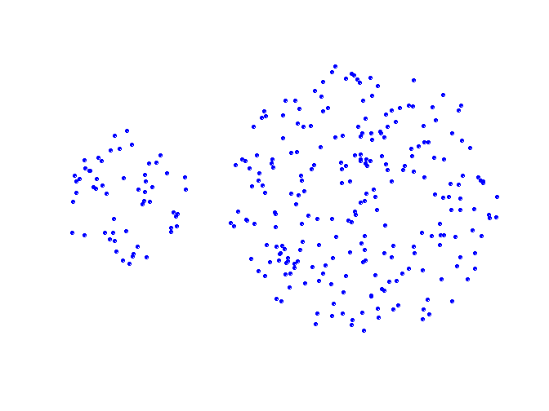
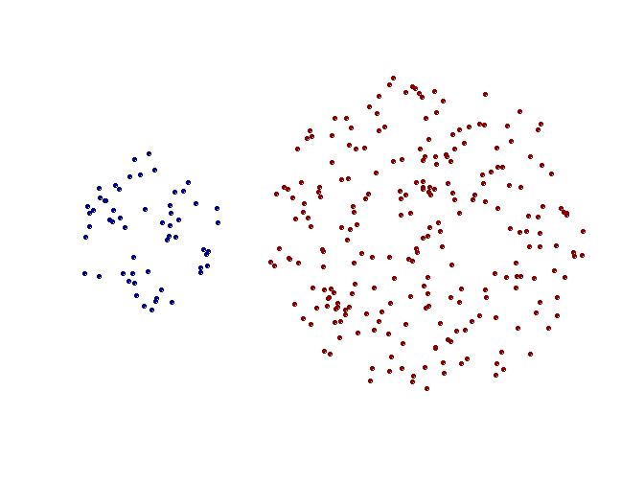
Strength of MIN
Original Points
Two Clusters
Can handle non-elliptical shapes

Slide 41
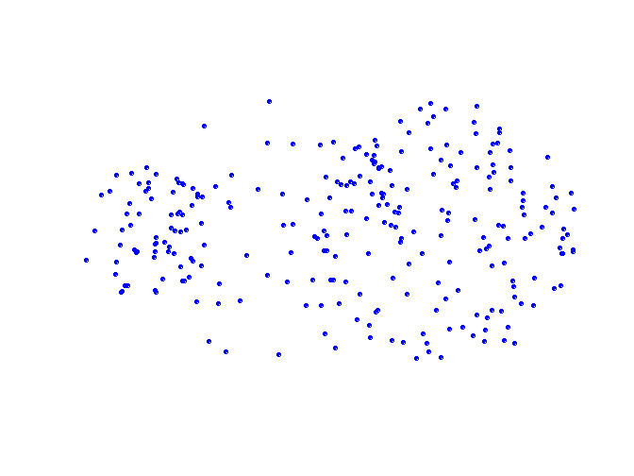
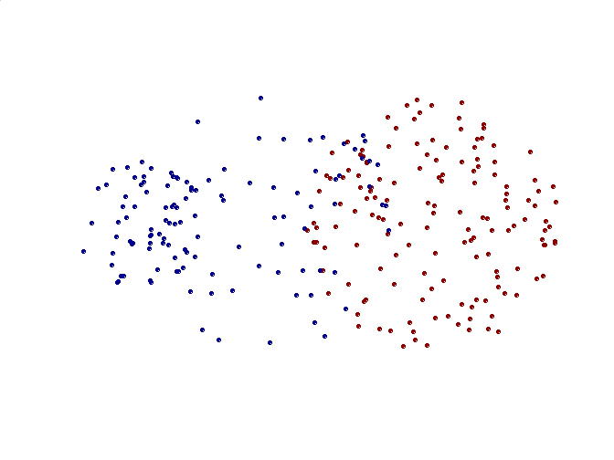
Limitations of MIN
Original Points
Two Clusters
Sensitive to noise and outliers

Slide 42
How to Define Inter-Cluster Similarity
Proximity Matrix
p1
p2
p3
p4
p5
. . .
p1
p2
p3
p4
p5
.
.
.
MIN
MAX(Complete Link): Similarity of two clusters is based on the two least similar (most distant) points in the different clusters. Determined by all pairs of points in the two clusters
Group Average
Distance Between Centroids
Other methods driven by an objective function
Ward’s Method uses squared error

Slide 43
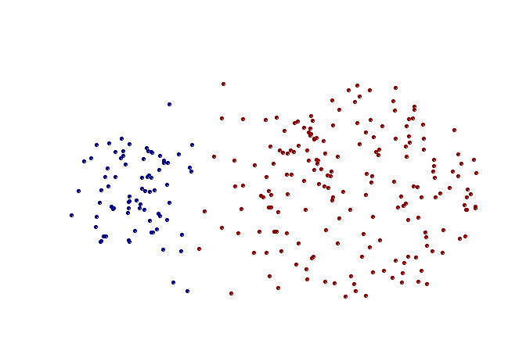
Strength of MAX
Original Points
Two Clusters
Less susceptible to noise and outliers

Slide 44
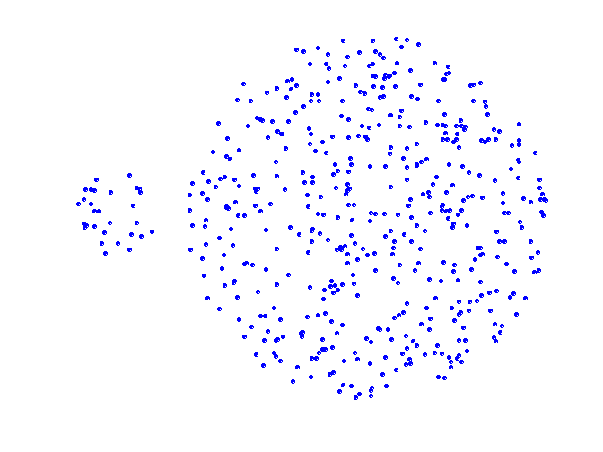
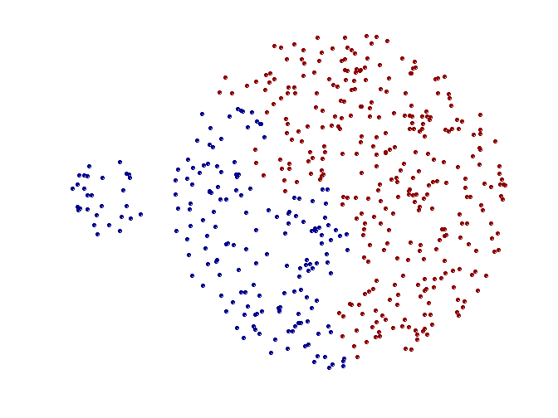
Limitations of MAX
Original Points
Two Clusters
Tends to break large clusters
Biased towards globular clusters

Slide 45
How to Define Inter-Cluster Similarity
Proximity Matrix
p1
p2
p3
p4
p5
. . .
p1
p2
p3
p4
p5
.
.
.
MIN
MAX
Group Average Proximity of two clusters is the average of pairwise proximity between points in the two clusters
Distance Between Centroids
Other methods driven by an objective function
Ward’s Method uses squared error

Slide 46
Hierarchical Clustering: Group Average
Compromise between Single and Complete Link
Strengths
Less susceptible to noise and outliers
Limitations
Biased towards globular clusters

Slide 47
How to Define Inter-Cluster Similarity
Proximity Matrix
p1
p2
p3
p4
p5
. . .
p1
×
×
p2
p3
p4
p5
MIN
MAX
Group Average
Distance Between Centroids
.
.
.

Slide 48
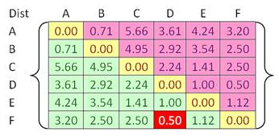
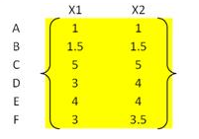
Example
Given an input distance matrix based on object features
We have 6 data points, we put each one into one cluster
Our goal is to group those 6 clusters such that
at the end of the iterations, we will have only single cluster
consists of the whole six original objects.
The closest cluster is between cluster F and D with
shortest distance of 0.5.
we group cluster D and F into cluster (D, F).
Then we update the distance matrix

Slide 49
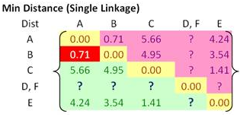




Example
Using single linkage, we specify minimum distance between original objects of the two clusters.

Slide 50
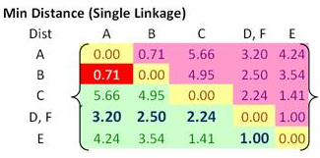

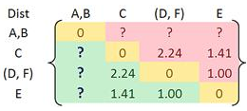
Example
The closest distance between B and A is minimum.
We group cluster A and cluster B into a single cluster (A, B).

Slide 51
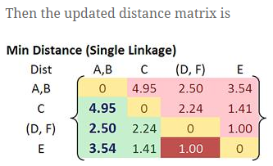
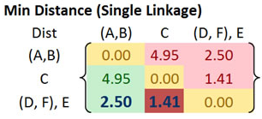
Example
We cluster them together into ((D, F), E ).

Slide 52
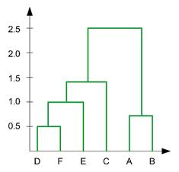

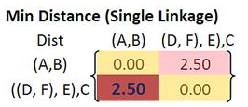
Example
we merge cluster ((D, F), E) and cluster C into a new cluster name (((D, F), E), C).
Updated matrix :

Slide 53
Hierarchical Clustering: Problems and Limitations
Once a decision is made to combine two clusters, it cannot be undone
No objective function is directly minimized
Different schemes have problems with one or more of the following:
Sensitivity to noise and outliers
Difficulty handling different sized clusters and convex shapes
Breaking large clusters

Slide 54
DBSCAN
DBSCAN is a density-based algorithm.
Density = number of points within a specified radius (Eps)
A point is a core point if it has more than a specified number of points (MinPts) within Eps
These are points that are at the interior of a cluster
A border point has fewer than MinPts within Eps, but is in the neighborhood of a core point
A noise point is any point that is not a core point or a border point.

Slide 55
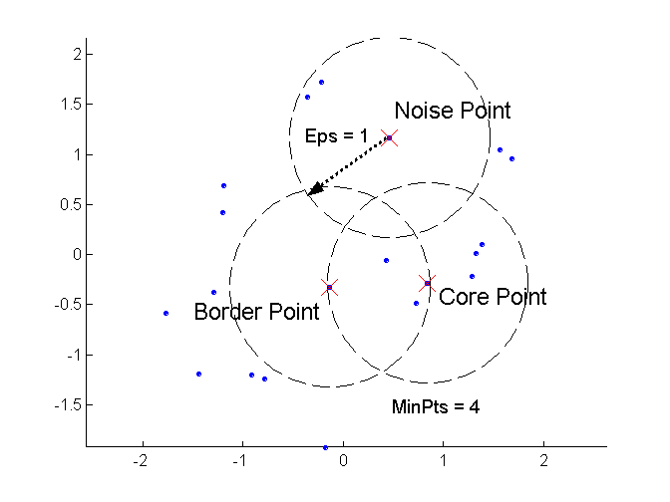
DBSCAN: Core, Border, and Noise Points

Slide 56
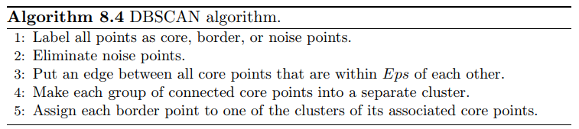
DBSCAN Algorithm
Eliminate noise points
Perform clustering on the remaining points

Slide 57
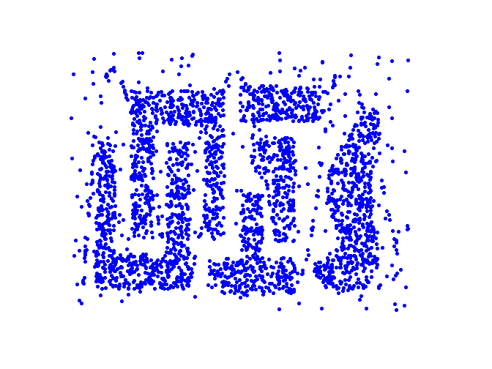
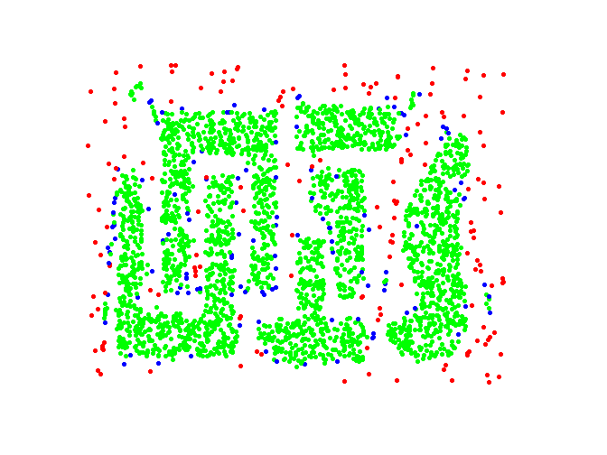
DBSCAN: Core, Border and Noise Points
Original Points
Point types: core, border and noise
Eps = 10, MinPts = 4

Slide 58
When DBSCAN Does NOT Work Well
Varying densities
High-dimensional data

